Slide 1
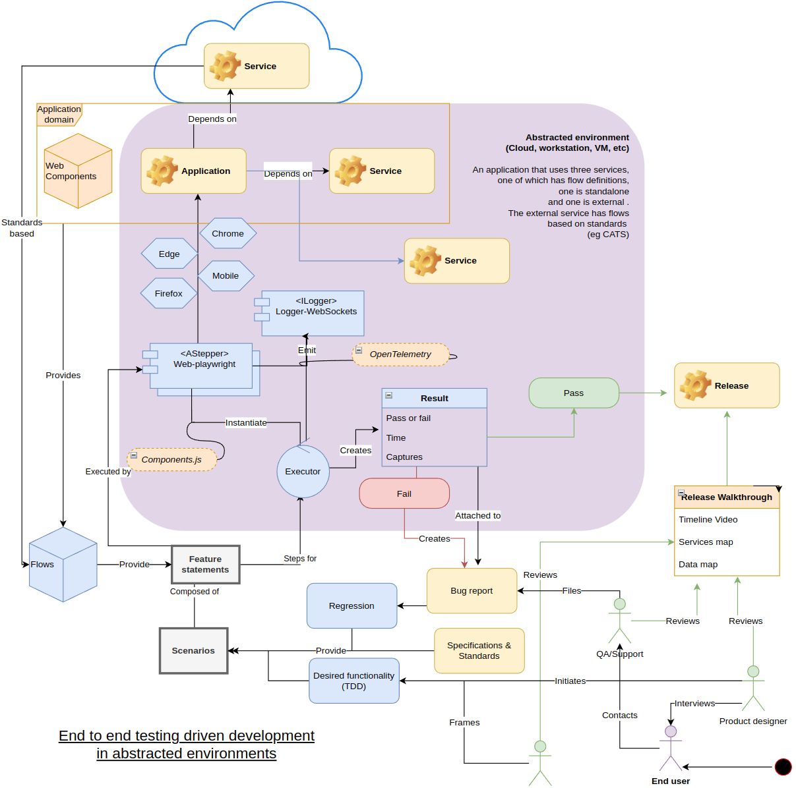
Haibun End to end specification driven development in abstracted environments
Load tests
https://github.com/withhaibun/haibun-load-tests
May, 2024
Overview diagram

Slide 2
Important elements of Haibun
Reduce the friction for developing high standard products (specs, tests, documentation)
Understandable by anyone, produce clear artifacts
Fits into existing systems, one piece of the puzzle
Development pipelines
Local or cloud environments
Very high level of re-use: Specification → flows → features → scenarios -> steps
Re-use for e2e, load tests
Easy setup

Slide 3
Standalone test
Feature: Account Creation Workflow on Wiki
Backgrounds: site, form-create-account
Scenario: Navigating and creating an account on a local Wiki page
We start by creating a random username and password, and what will become the user page.
When I have a valid random username <username>
When I have a valid random password <password>
Go to the create account page, and fill it in, starting with the gc institution.
go to the Main webpage
resize window to 1400x1100
then click by text "Create account"
input <username> for Institution email
We have to pause a bit to get the form to recognize the name and institution have been entered, so it will populate the username field.
pause for 1s
Press "Tab"
Type "c"
input <password> for Create password input
input <password> for Confirm password input
input "test account" for Real name
Click the checkbox Accept terms
Click on Create account
Now the new user has been created, there should be an announcement popup with this information.
Follow the link.
In Notification title, see "User page Created"
Click "here"
Confirm we're on the new user page.
URI starts with User page
https://github.com/gctools-outilsgc/gcpedia/blob/load-tests/haibun/e2e/features/account/create-account.feature

Slide 4
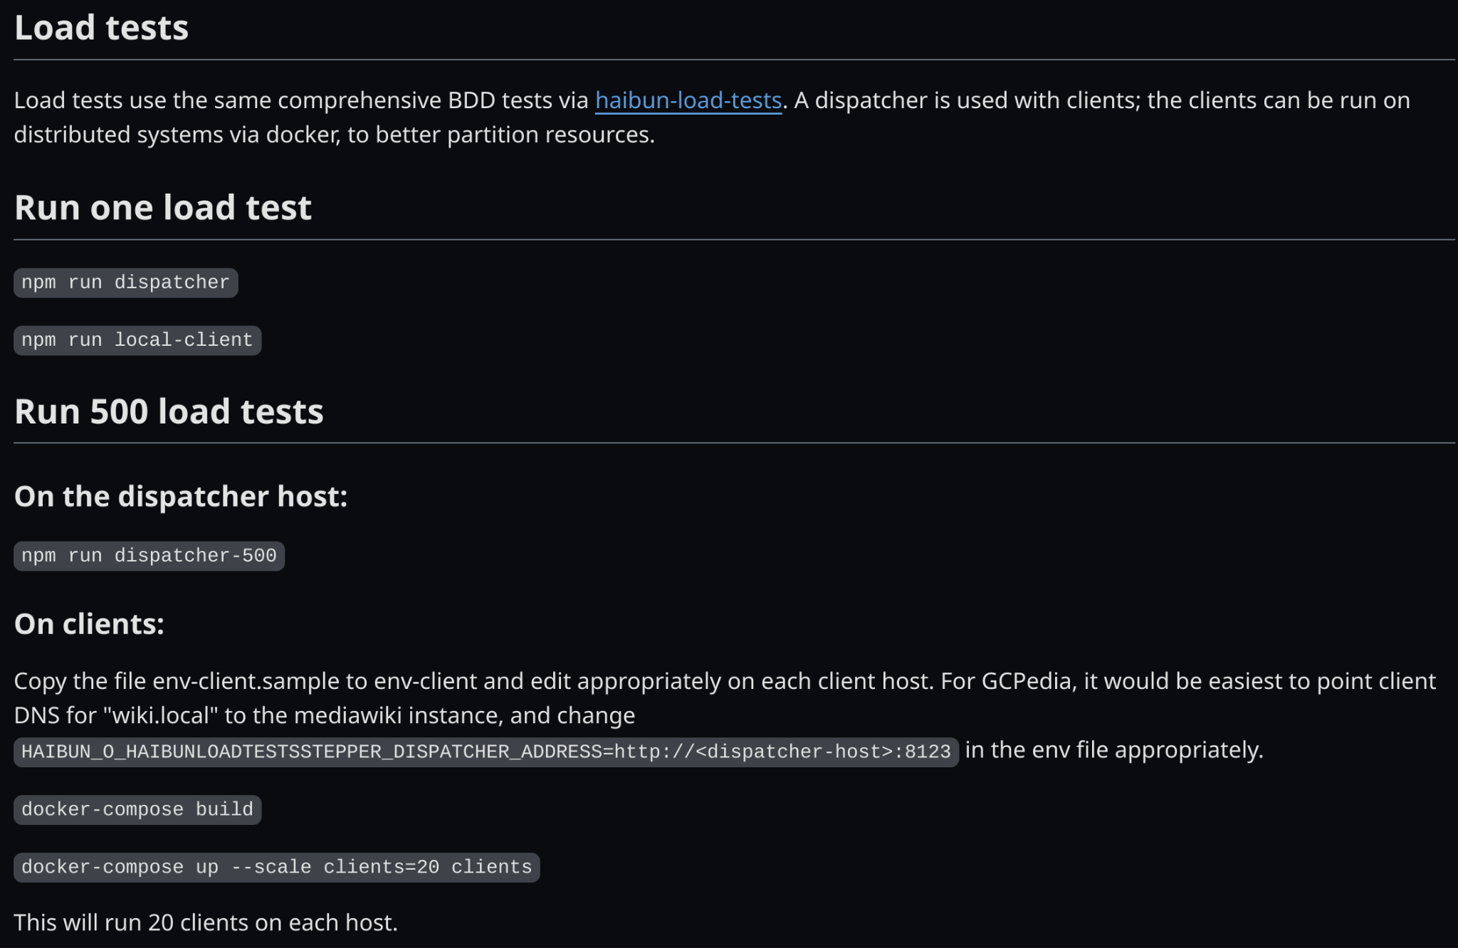
Running tests
Uses docker-compose for horizontal scalability locally or in the cloud
https://github.com/gctools-outilsgc/gcpedia/blob/load-tests/haibun/README.md

Slide 5
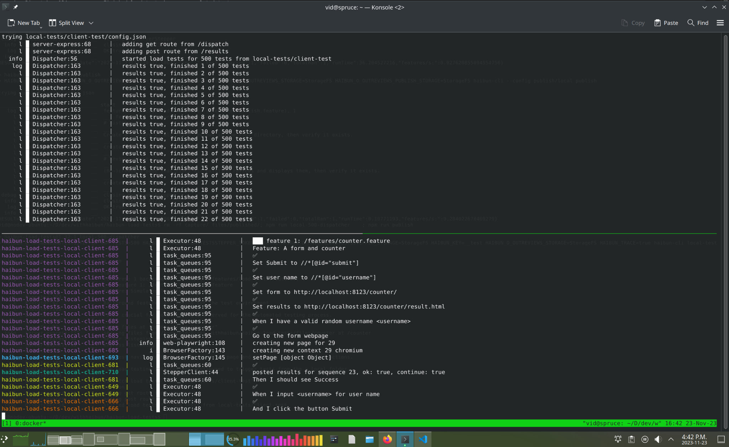
Running the load test locally using Docker
Host 1: docker compose up --build --scale clients=20
Host 2: docker compose up --build --scale clients=50

Slide 6
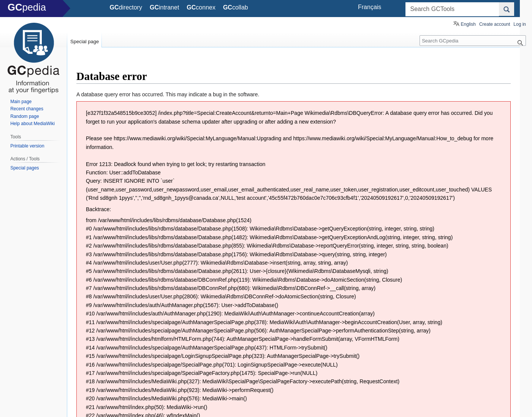
Findings
Database errors on a small percentage of tests. https://github.com/gctools-outilsgc/gcpedia/issues/241
How would these errors be found without load tests?

Slide 7
Next steps
Address create account issue?
Adapt tests for create page, Random Page (cache busting)
Individual test results in review
Statistics
Test in cloud

